Slide 1


Slide 2


Slide 3
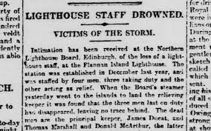
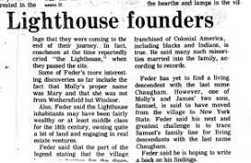
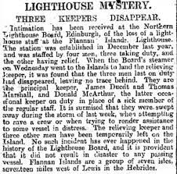


In December 1900, British newspapers published a strange piece of news with different headlines: The disappearance of the guards,
the secret of the lighthouse

Slide 4
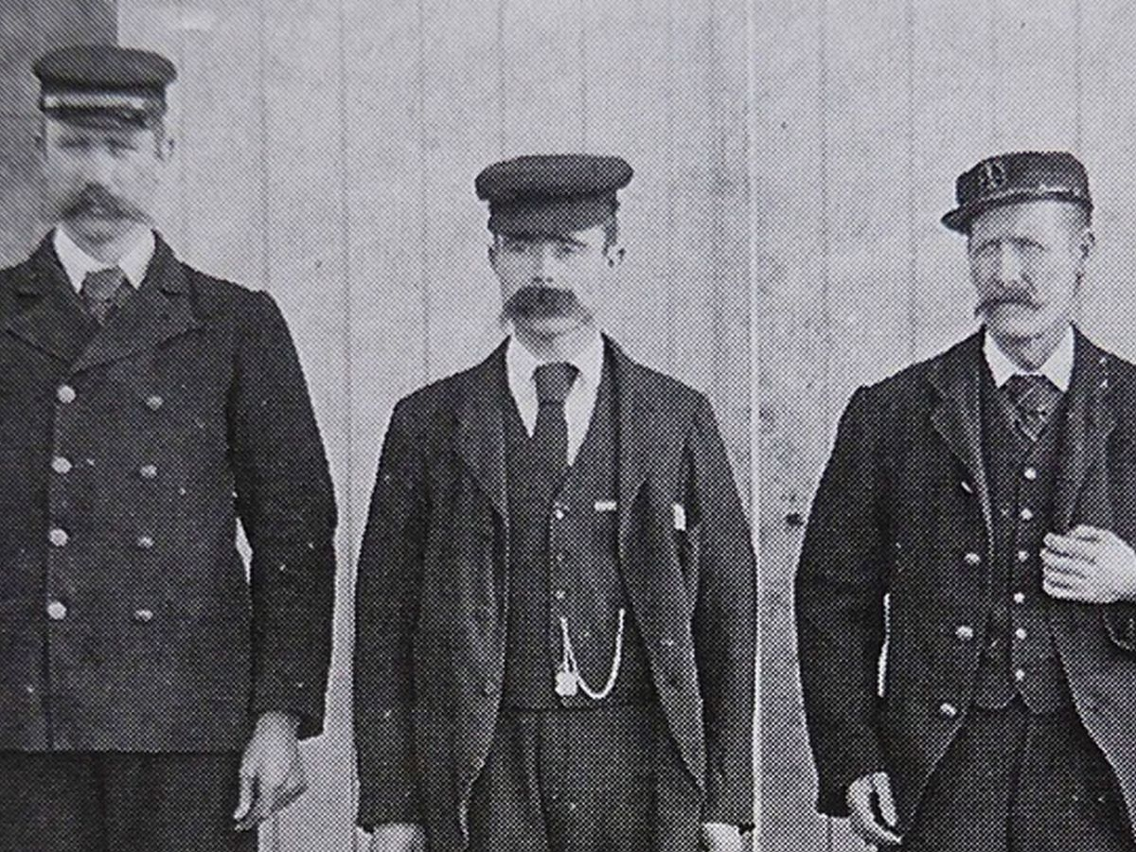
On the famous Flannan Island, where the rocks do not allow ships to cross.
Therefore, the Northern Lighthouse Company decided to build a lighthouse above it and assigned the three men to keep the lights of that lighthouse shining throughout the night to guide ships and sailors, to land and harbor
Donald mcarthur
James ducat
Thomas marshall

Slide 5
but as the days passed, ships passing near the island began to notice something strange: the lighthouse lights were no longer shining…….?!

Slide 6
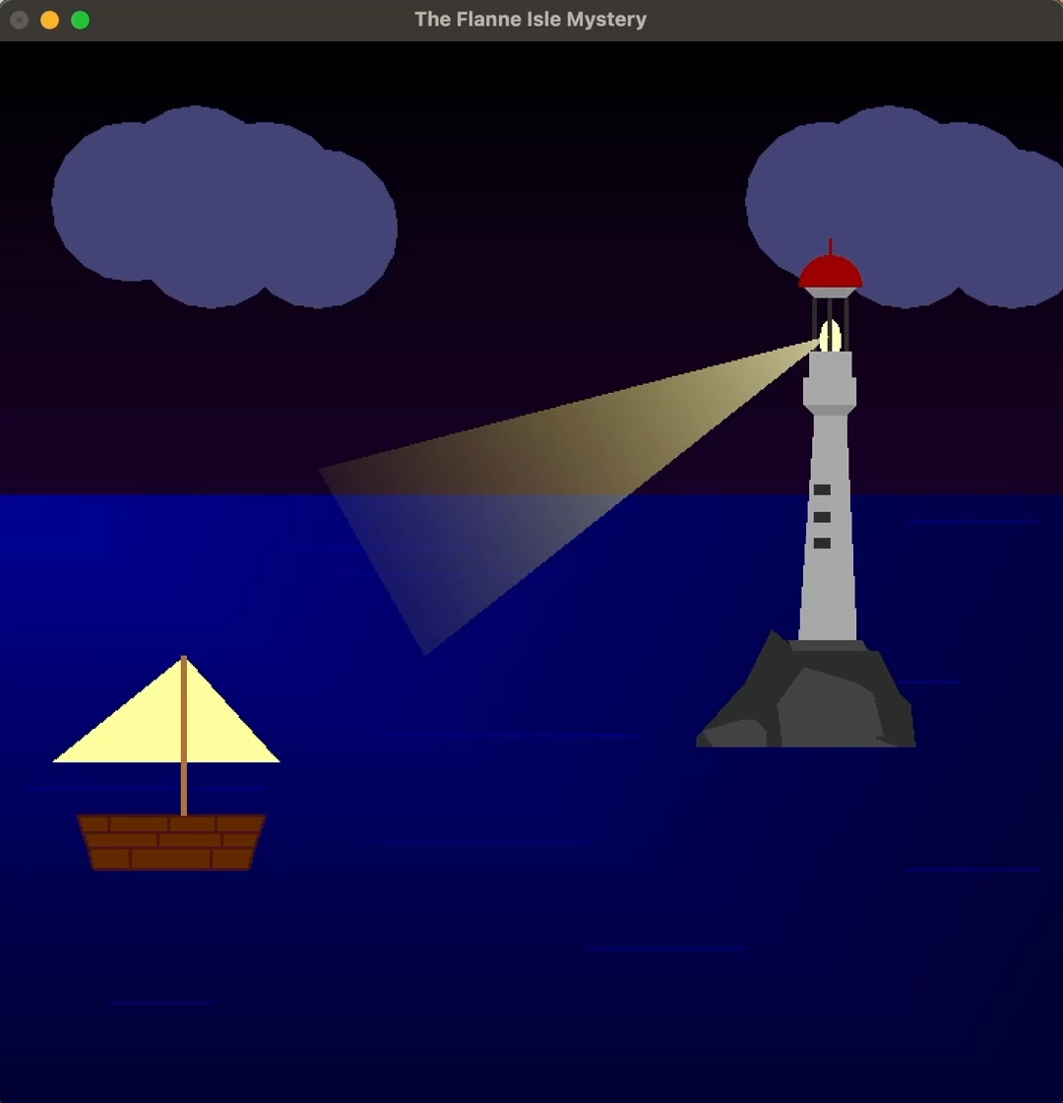

Slide 7
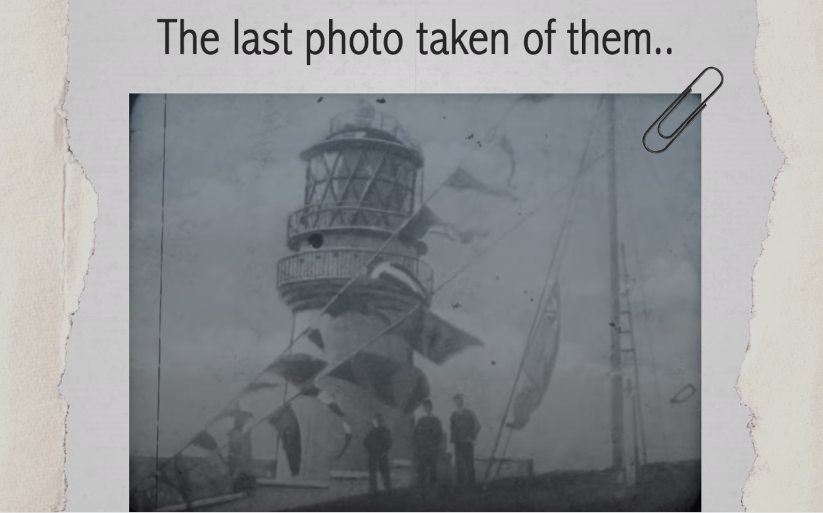
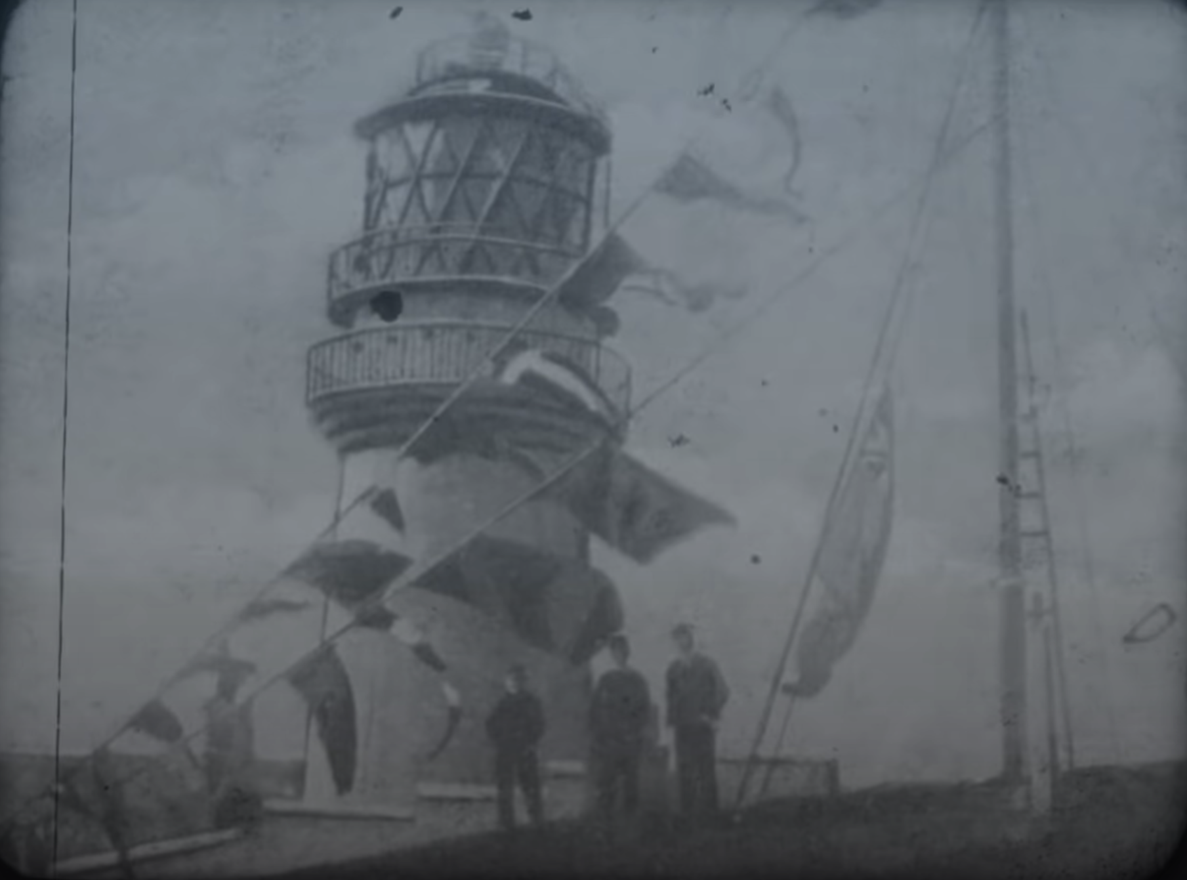
The last photo taken of them..

Slide 8
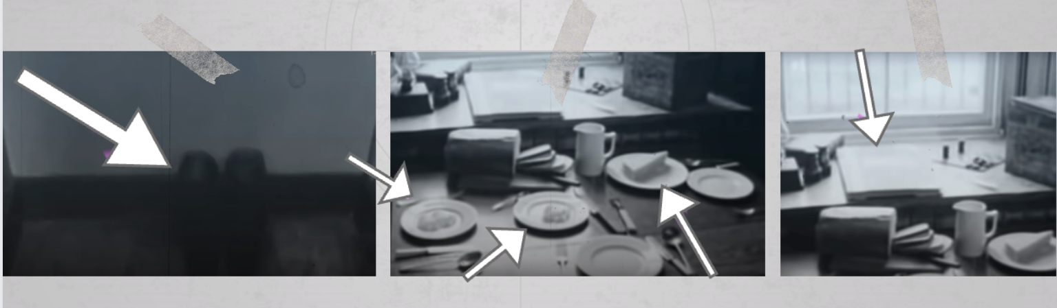
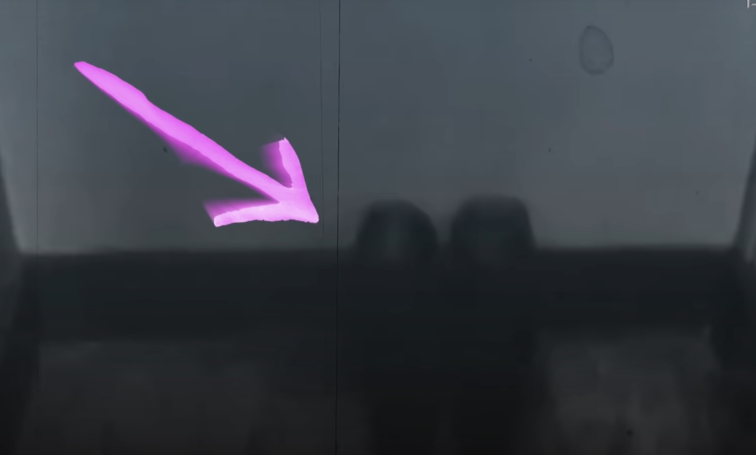
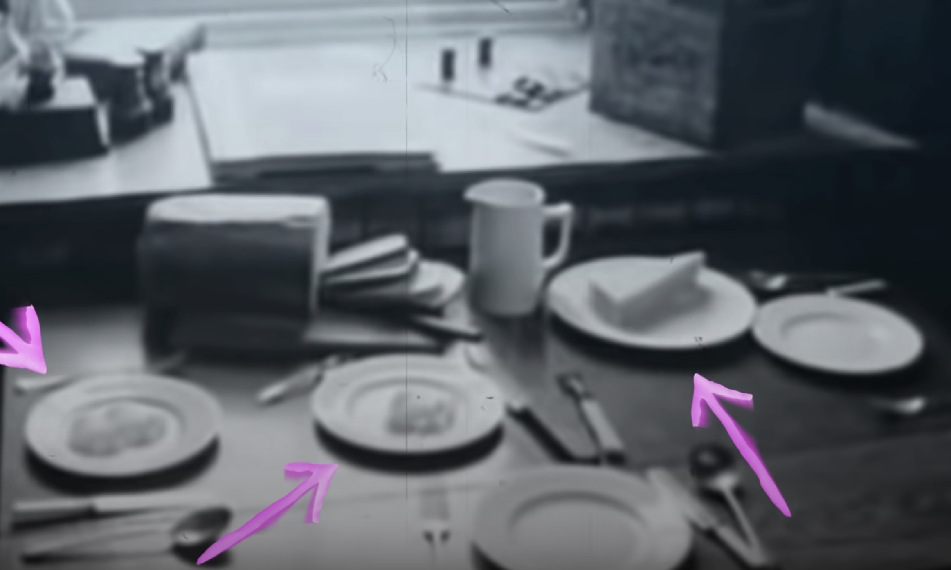
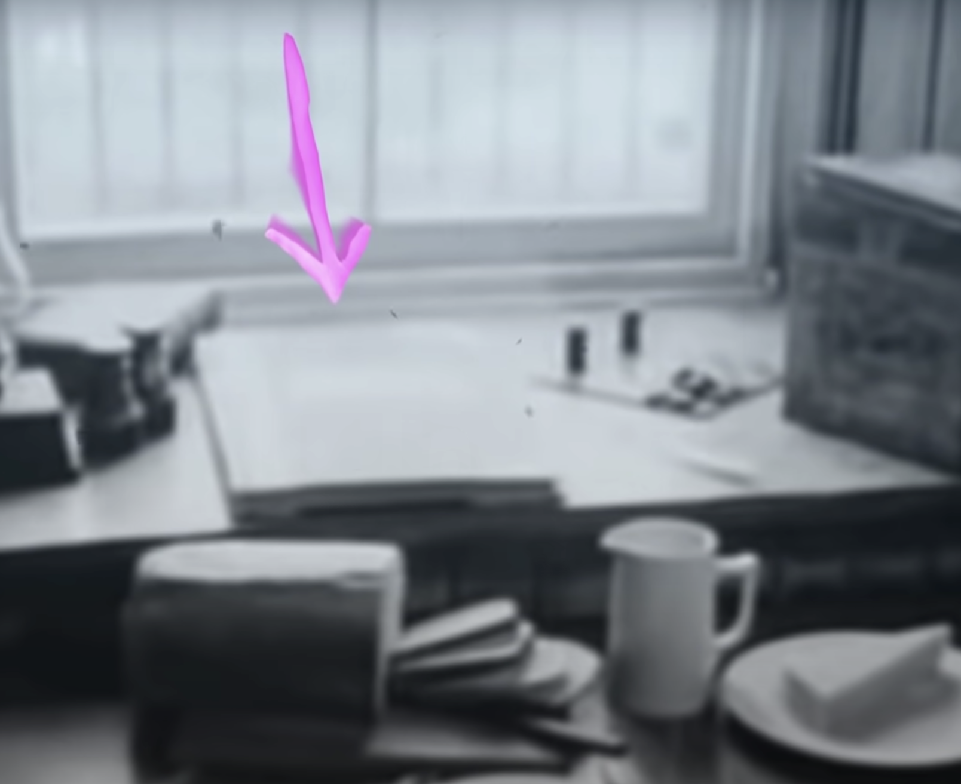
The company was notified, so they sent a team to determine the reason. When they arrived on the island, they did not find the three guards. All they found were a shoes, three plates, and Thomas Marshall’s diary.

Slide 9
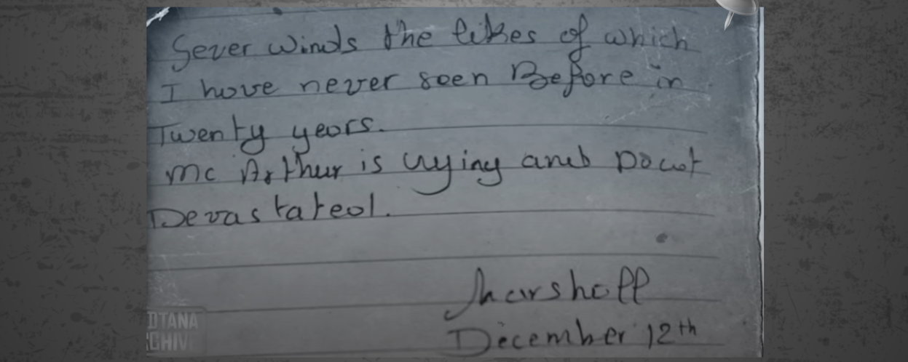
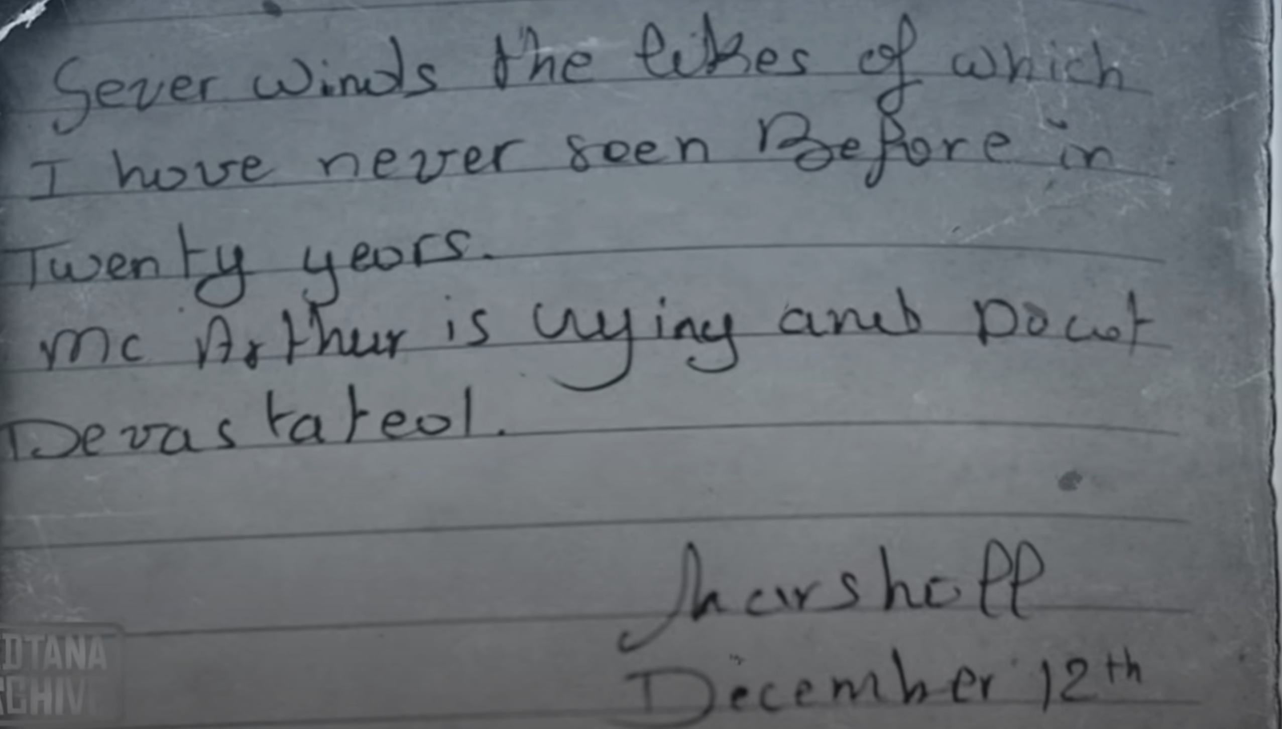
Everything was normal except for what Thomas wrote in his diary: “A strong wind, the likes of which I have never seen before in 20 years.” What is strange is that the crew is professional and accustomed to storms. But the strangest thing is that there was no storm on those nights!!!

Slide 10
The investigator did not find evidence to explain what happened, and to this day no one knows the reason for their disappearance.......

Slide 11
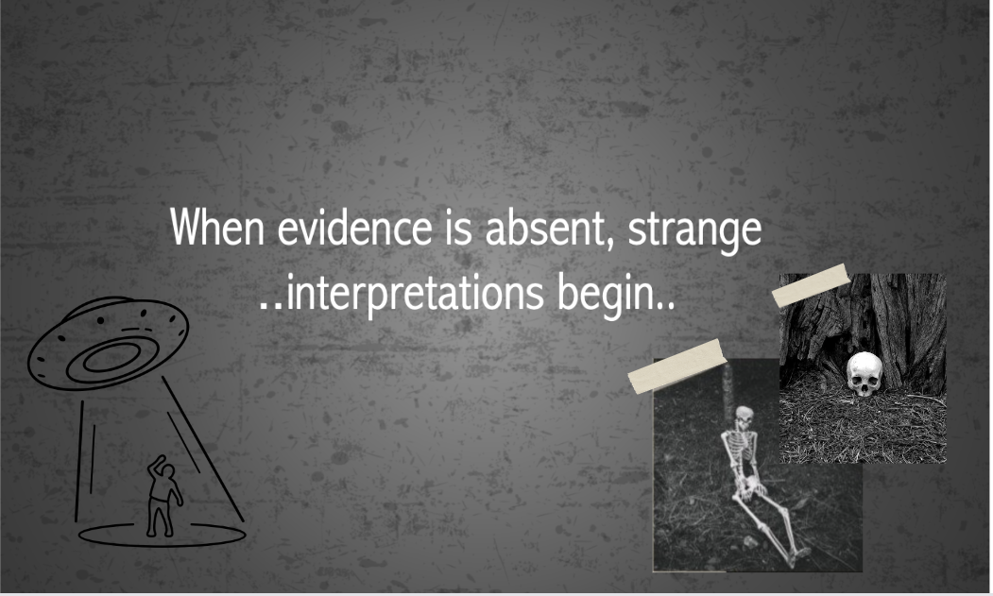
When evidence is absent, strange interpretations begin....

Slide 12
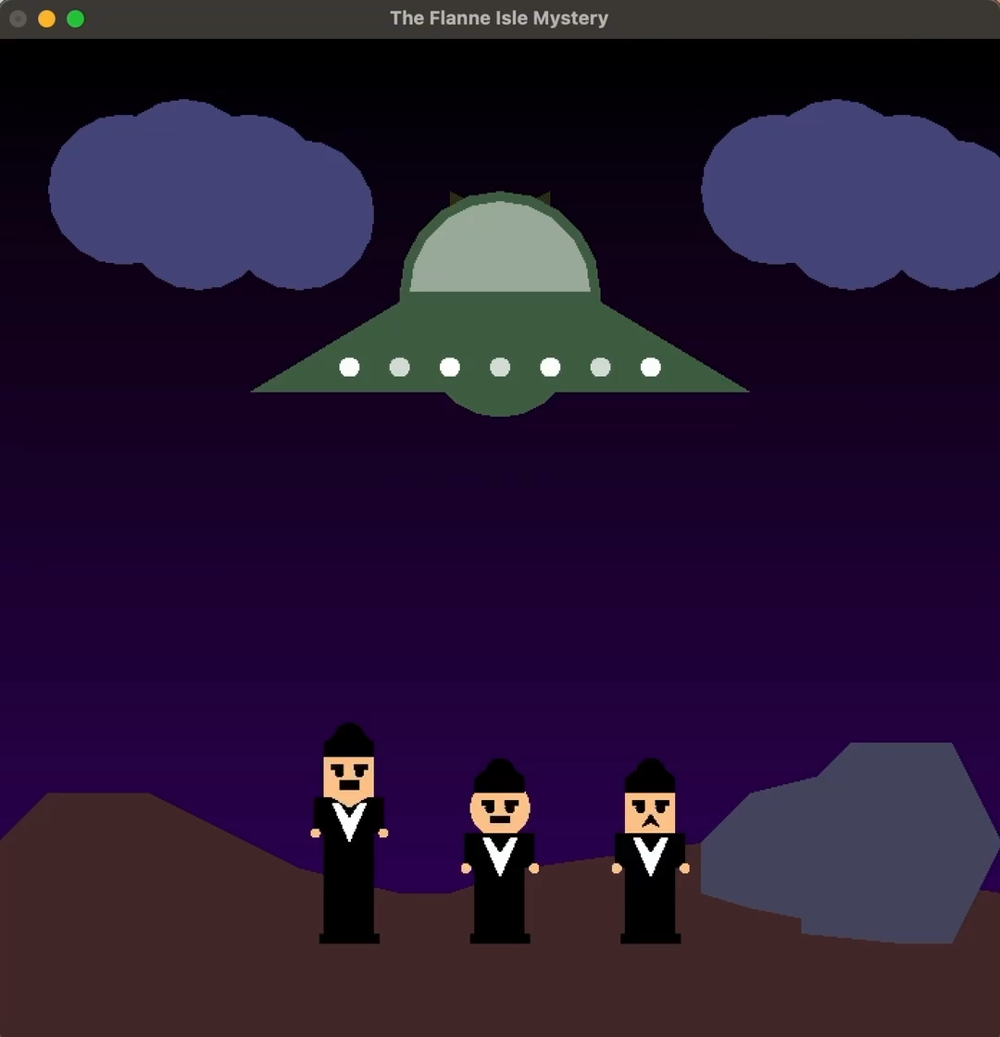

Slide 13
These method are for the third scene:
Void ground()
Void Background()
Void Cloud()
Void Boom()
Void Beam()
Void Man()
Void Man2()
Void Man3()

Slide 14
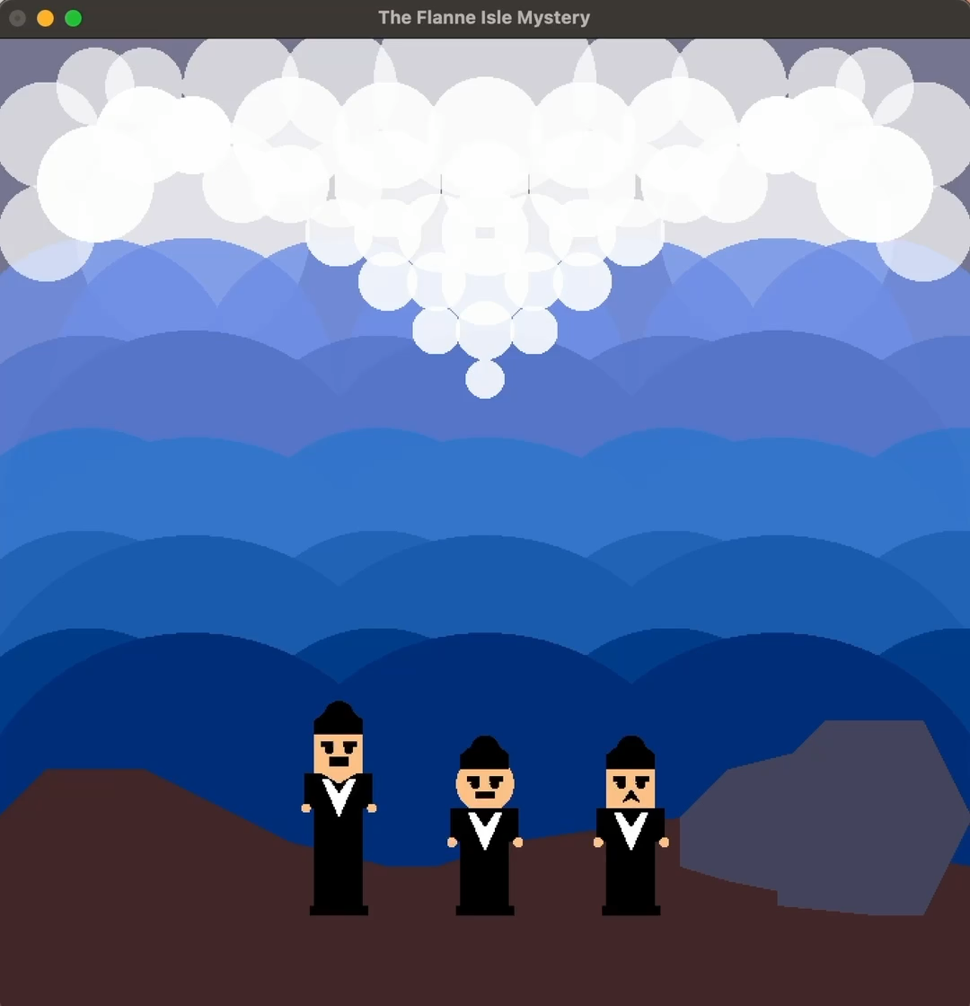

Slide 15
These method are for the fourth scene:
Void Big2Circles()
Void SeaWaves1()
Void SeaWaves2()
Void SeaWaves3()
Void SeaWaves4()
Void BackWaves1()
Void BackWaves2()
Void BackWaves3()
Void BackWaves4()
Void BackWaves5()
Void SeaFoam1()
Void BackSeaFoam()
Void FrontSeaFoam()

Slide 16
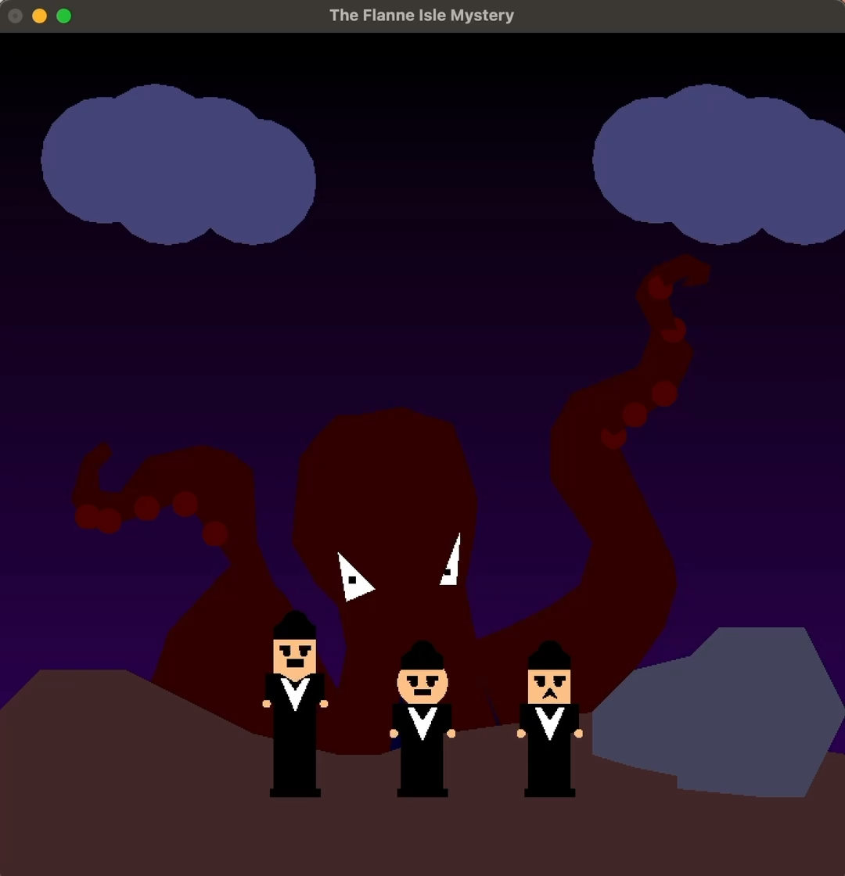

Slide 17
These codes are for the fifth scene:
Void Squ()
Void SquAr()
Void SquAl()

Slide 18
These codes are for the second scene:
Void Ocean()
Void OceanLines()
Void Light()
Void Light1()
Void Boat()
Void Island()
Void Lighthouse()

Slide 19
These codes are for the first scene:
Void Click()

Slide 20
Here we collected all the animations into 1 animation for each scene, displayed them on the screen, and performed the transformation operations
Void Display()
Void lighthouseBoat()
Void Spaceship()
Void Storm()
Void gintSquid()

Slide 21
This key function() is for switching between scenes by pressing a specific button to go to the next scene:
Void Key()

Slide 22
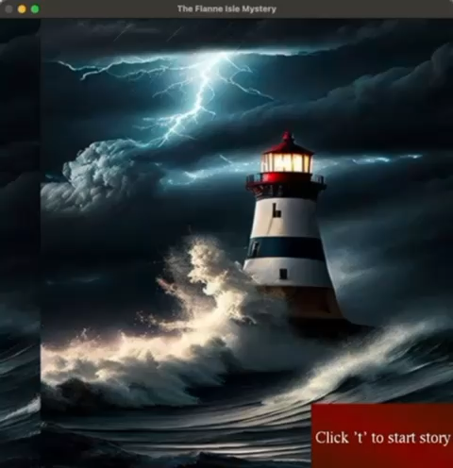

Slide 23
Dremers🪄
Khadija Alajmi (leader)
Jood Al-Sufyani
Futun Al-Harithi
Jana Al-Mesbahi

Slide 24
Fin

